Slide 1

Bank Churn Rate
By Zoe Philip-Iyawa

Slide 2

Introduction
Factors that cause churn rate in financial sector
During my time in the financial sector, I frequently encountered customers who would approach me saying, 'Hi, I'd like to close my account.' These interactions prompted me to wonder: What drives customers to leave their banks?

Slide 3

Hypothesis
Customer churn in banks is influenced by a combination of factors, including but not limited to:
Low Credit score
Lower Age Group
Inactive membership status
Low salary
Geographic location and gender

Slide 4
Data source: https://www.kaggle.com/datasets/gauravtopre/bank-customer-churn-dataset/data
Mixed data type
Kaggle platform
10,000+ rows
12 unique columns
Data Collection

Slide 5

Data Preparation
Data cleaning and transformation steps
Remove duplicates
Handle missing values and outliers
Standardize columns
Normalize the dataset
Group Numbers into categorical variables USING NESTED IF

Slide 6
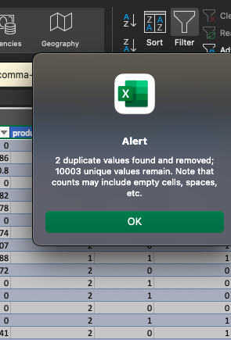
Remove Duplicates

Slide 7
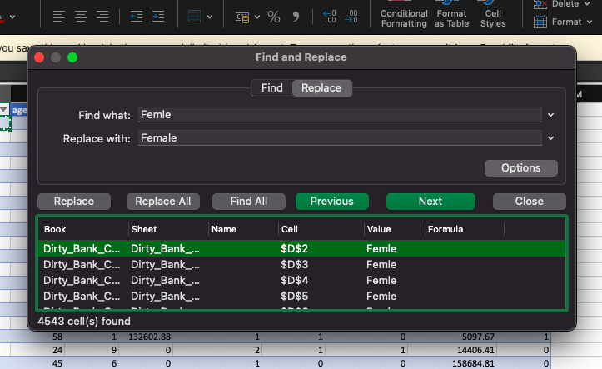
Standardize columns

Slide 8
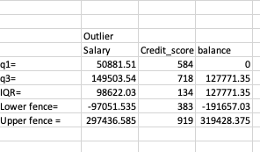
Handle Outliers

Slide 9
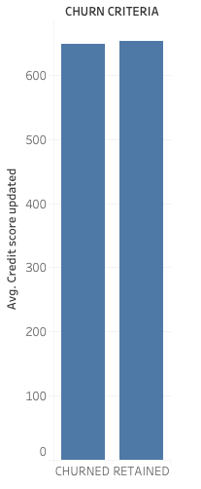
Question 1: Did Credit score affect churned criteria ?

Slide 10
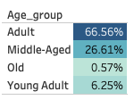
Question 2: Did Age affect churned rate ?

Slide 11
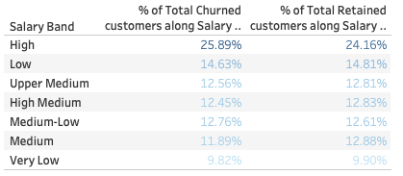
Question 3: Did average salary affect churned criteria ?

Slide 12
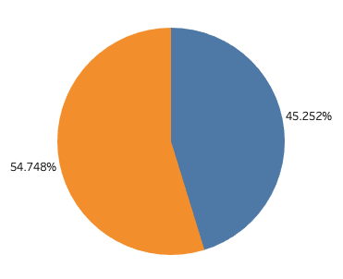
Question 4: Did gender affect churned rate ?
Female
Male

Slide 13
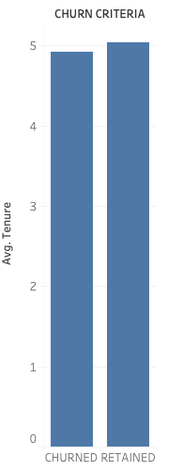
Question 5: Did average tenure affect churned criteria ?

Slide 14
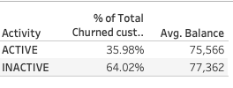
Question 6: Did members activity and balance affect churned rate ?

Slide 15
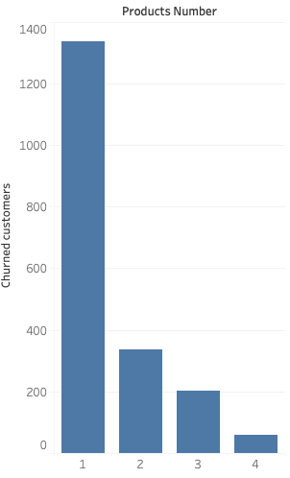
Question 8: Did number of products held affect churned rate ?

Slide 16
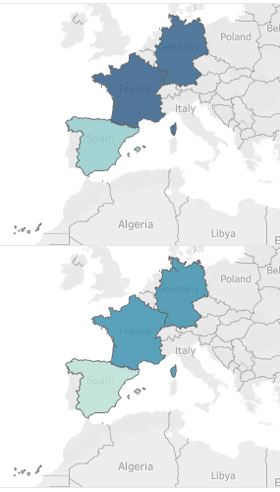
Question 9: Did geographical location and gender affect churned rate ?

Slide 17
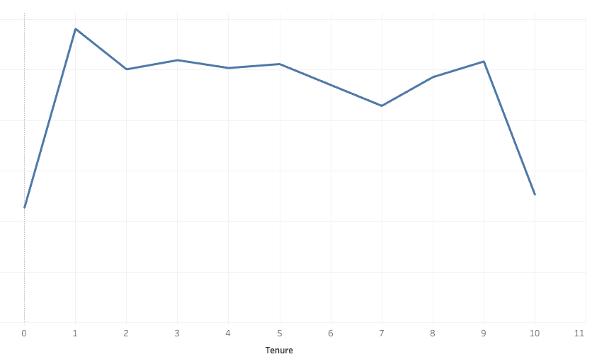
Question 10: Is there a specific point where churned rate peaked ?

Slide 18

Insights
Young adults have low churn rate.
Lower-income earners have low churn rate.
Male customers have a higher churn rate than females
Inactive customers have a higher churn rate than males
Customers with fewer products are more likely to churn
Germany and France have higher churn rates.
Churn rates increased gradually over the years, but not significantly

Slide 19

Recommendations
Track churn by tenure milestones.
Investigate specific drivers of churn in France and Germany
Conduct surveys to understand specific needs and concerns.
Engage Inactive Customers with Re-Engagement Campaigns
Introduce premium services or rewards for High-income earners (e.g., high saving options, premium credit options).

Slide 20

Questions ?

